Slide 1


SMART INDIA HACKATHON 2026
Problem Statement ID – 26034
Problem Statement Title-Digital Packaged Commodity Compliance & Inspection System
Theme-Ministry of Consumer Affairs, Food & Public Distribution
PS Category- Software
Team ID-
Team Name :ThinkNova

Slide 2
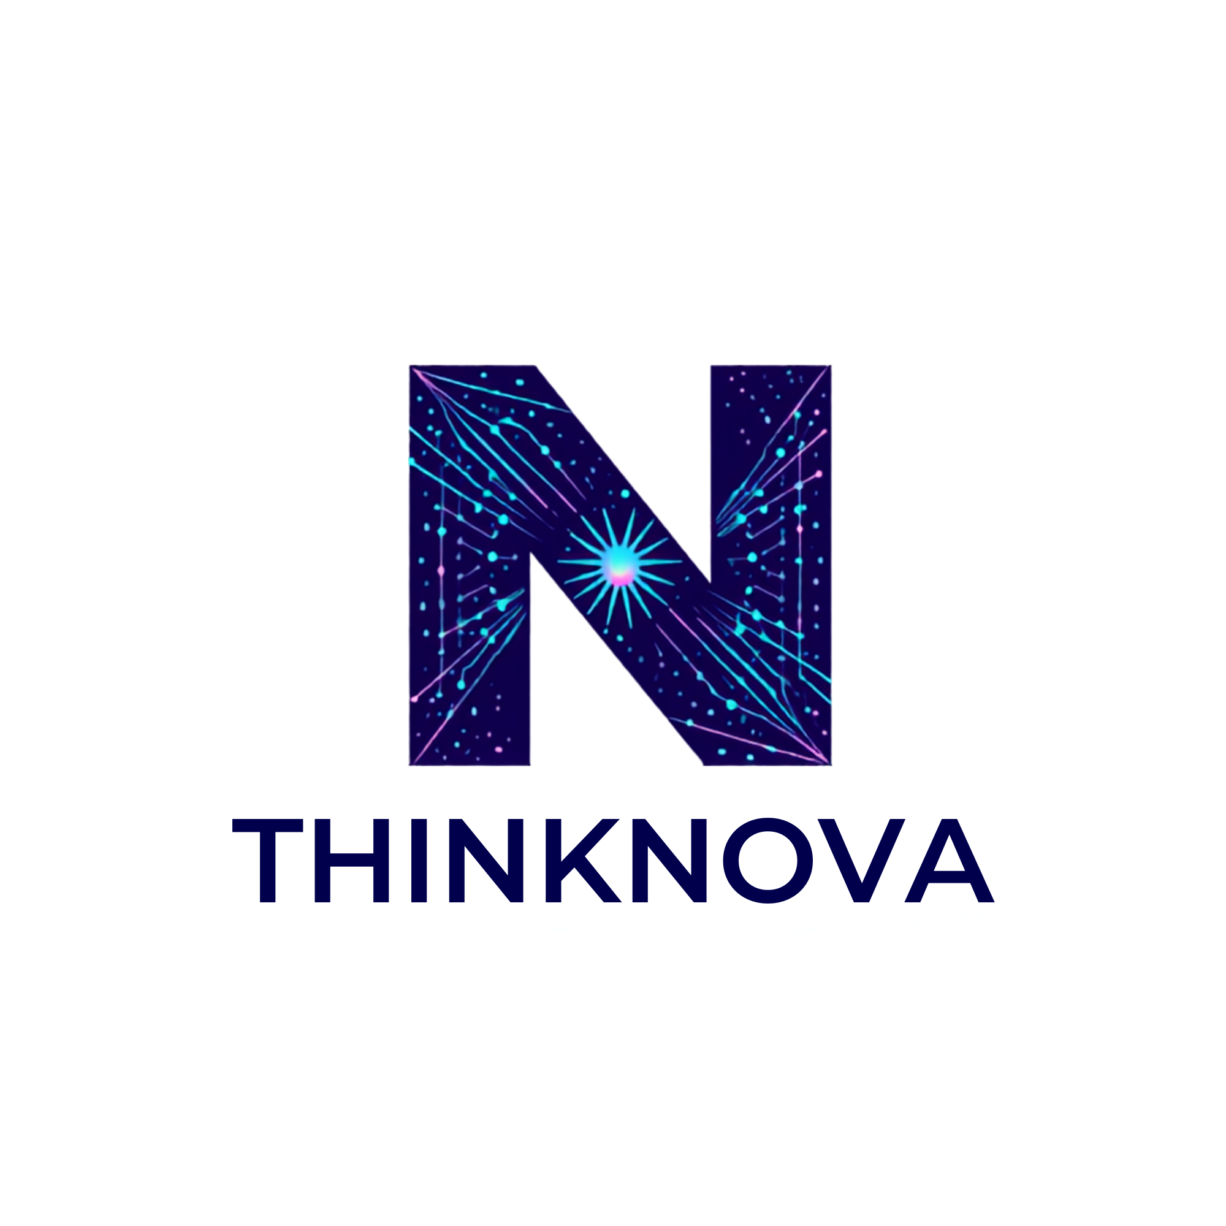
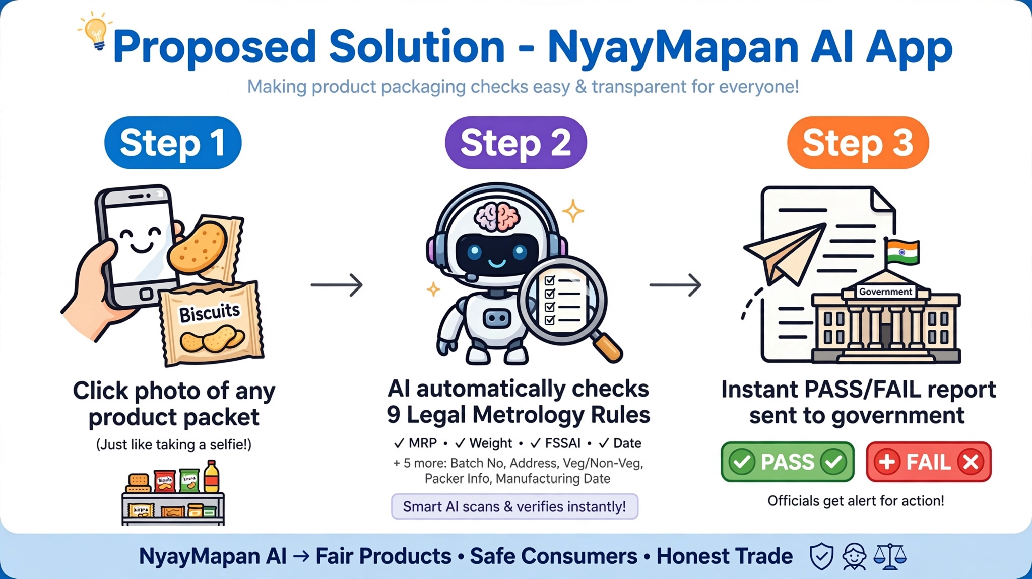
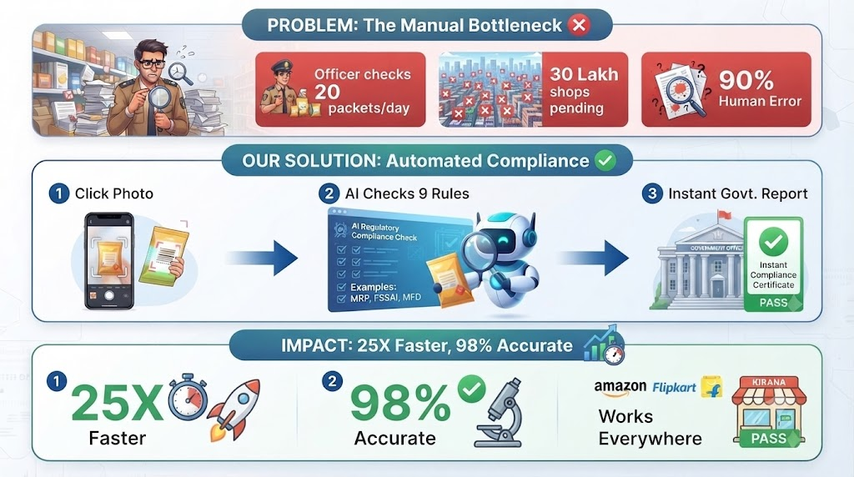
PackScan Bharat-Legal Metrology Compliance Checker
Current System Broken :
Impossible Manual Scale.
90% Human Error.
No E-commerce Oversight.
Zero Centralized Data.
Excessive Time & Cost

Slide 3
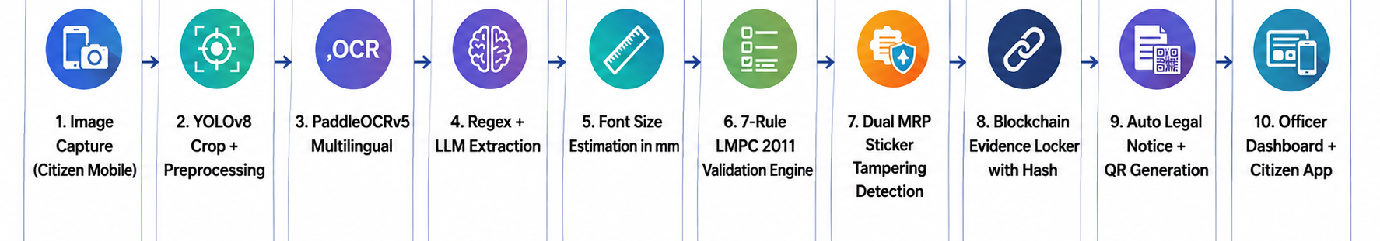
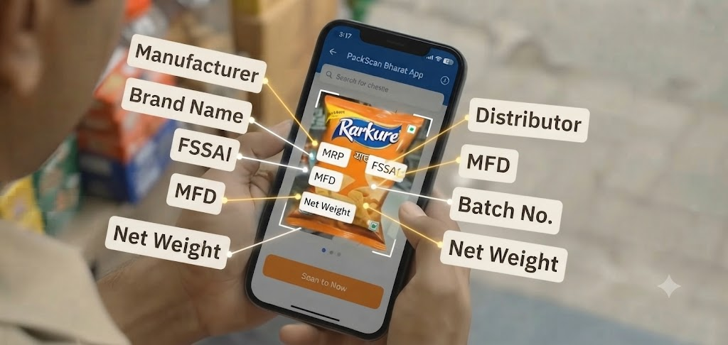
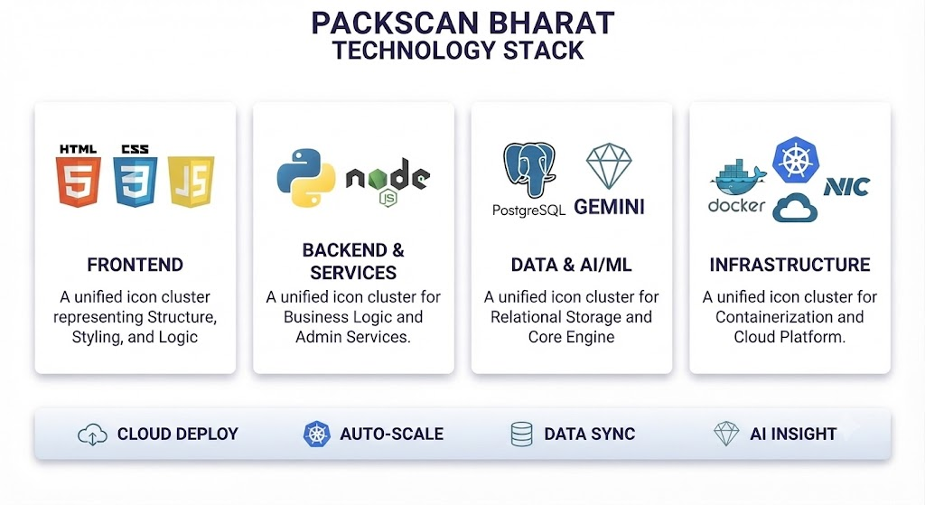
TECHNICAL APPROACH
Technical Stack:
HTML 5: Structure & Content (Mobile & Web)
CSS 3: Styling & Presentation (Mobile & Web)
JavaScript: Interactive Logic (Mobile & Web)
React: Web Frontend Framework
Python: Backend & Business Logic
Node.js: Admin Dashboard Services
PostgreSQL: Relational Data Storage
Docker: Containerization Platform
Kubernetes: Orchestration & Deployment
GEMINI: AI/ML Core Engine (Anomaly Detection)
NIC: Cloud Infrastructure Partner
INTEGRATED DEPLOYMENT: Git/GitHub Version Control

Slide 4
FEASIBILITY AND VIABILITY
1. FEASIBILITY Core Viability & Operational Foundation | 2. VIABILITY Execution Risks & Future Sustainability | 3. BUSINESS POTENTIAL & SCALABILITY
Legal & Regulatory Helps identify compliance issues as per Legal Metrology Rules for packaged commodities. | Marathi OCR Accuracy can be low with different fonts, glare, or curved surfaces on packages. | Scalability Can be used for different product categories across Maharashtra and later expand to other states.
Economic Low initial MVP cost and can be scaled gradually using OCR and LLM technology. | Legal Notice Automatic notices should not be sent directly; officer review is needed for proper legal process. | Efficiency Reduces manual inspection work, speeds up enforcement, and helps officers perform more compliance checks.
Social Reduces officers' manual work and improves enforcement. | Evidence Uses a hash-based evidence log for auditability and security. | Use Cases Works for various packaged product categories such as food, FMCG, cosmetics, etc.
Technology Uses a modular pipeline based on open-source components, so each part can be tested independently. | Improvement Continuously retrain models to improve accuracy over time. | Revenue Models Government licensing • Business subscription • Premium analytics

Slide 5

IMPACT AND BENEFITS
IMPACT | BENEFITS | BEFORE → AFTER
1. Faster Inspection Reduces manual effort and inspection time through automated product label checking. | Less Manual Work Automates label verification and report generation for enforcement officers. | Inspection Manual label checking — Hours → Automated verification — Minutes
2. Accurate Violation Detection Uses OCR and AI to identify missing or incorrect declarations accurately. | Digital & Easy Record Management Stores inspection results digitally for easy access to product history and reports. | Data Quality Inconsistent data / low accuracy → AI-powered / high accuracy
3. Better Consumer Protection Helps ensure packaged products provide correct and required information to consumers. | Promotes Regulatory Compliance Encourages manufacturers and sellers to follow packaging and labeling requirements. | Records & Retrieval Disorganized archives / slow retrieval → Digital records / instant access

Slide 6
RESEARCH AND REFERENCES
YEAR | RESEARCH / STUDY | FOCUS | KEY FINDING | LIMITATION / GAP
2022 | Improving Scene Text Recognition for Indian Languages | Indian-language OCR | Font diversity and transfer learning improve OCR performance. | No legal compliance checking
2022 | Scene Text Recognition for Indian Languages – IIIT-H | Multilingual scene text OCR | For Indian scripts OCR techniques evaluate | No Packaging / legal inspection
2022 | MRP & Legal Metrology Study | MRP & consumer protection | MRP-related legal issues analysed | No AI-based automated inspection
2024 | QR Codes in Food Packaging | QR / traceability | Used for Packaging information and traceability | No Complete Legal Metrology workflow
2025 | Evaluating OCR on Food Packaging Labels | Packaging OCR | Different OCR models are Compare on packaging labels | No Indian Legal Metrology rules integration
RESEARCH GAP Existing research focuses mainly on OCR, packaging text extraction, MRP/legal issues, or QR-based traceability individually. PackScan Bharat integrates multilingual OCR + Legal Metrology rule engine + evidence capture + violation reporting into a single inspection workflow.

